Slide 1

Movie insights project
Wamuyu Gitonga, Lilian Wangui, Natalie Wanjiku, John Njogu, Leejay Mwakereti, Vanessa Sandra.

Slide 2
Agenda
Introduction
Business understanding
Data understanding
Methods
Recommendations
Q & A
Conclusion

Slide 3
Introduction
Unlocking new horizons

Slide 4
Overview
The company, looking to diversify its portfolio, has identified the film industry as a potential profitable business opportunity.
In this presentation, we will be reviewing areas in the film industry the company ought to focus on in order to drive profits as they embark on this exciting journey.

Slide 5

Business understanding
Understanding what the industry entails.

Slide 6
Business overview
The film industry business involves understanding how films are developed, financed, produced, distributed and monetized.
In order to make informed decisions on those areas, we are going to explore the types of films currently doing well, and let our findings guide our decisions.
1.
2.
Revenue streams
3.
Key players
4.
Trends and challenges
Film industry value chain
6

Slide 7
Business objectives
Maximize revenue and profitability
Optimize cost-efficiency during production
Achieve strong ROI for investors and stakeholders
Own valuable Intellectual Property
Create original or franchise-worthy content.
Build strong brand and audience loyalty
Establish production labels
Foster community engagement through fan engagements.
Attract and retain talent
Work with reputable actors, directors and writers

Slide 8
Data understanding
Description of the data used in the project

Slide 9

Data
The project used data from 4 different sources, namely;
Internet Movie Database (IMDB)
The Movie DB (TMDB)
Box Office Mojo (BOM)
The Numbers (TN)
f
9

Slide 10
Data description
The IMDB and TMDB databases contain general movie descriptions including their production crews and their biographies, movie ratings, and fan and critical reviews etc.
The TN and BOM datasets contain tracked systematic and algorithmic domestic and foreign box office revenues.
10

Slide 11
Methods
Analysis methods used in the project

Slide 12
Approach
Content analysis
The team examined the contents of the data for pattern identification and, analyzed the behavior of each column over specific periods of time.
Drill-down analysis
We also explored the datasets at an increased level of detail to understand the patterns we observed.
Prescriptive analysis
Post drill-down analysis, we made recommendations based on the analysis findings.
Predictive analysis
The team also made some predictions.

Slide 13

Recommendations
Our future.

Slide 14
Genre recommendations.
Portfolio strategies: Balance & Diversity.
We strongly recommend that the company focus on highly profitable genres that do well even on lower production budgets as well as balance high-profit, high-budget genres. However, we caution that not all blockbuster films succeed therefore we counsel that you consider making only 1/2 blockbuster movies per year while balancing smaller projects.
Genre type | Purpose
Animation / Horror / Documentary/ Thriller | Stable cash flow, lower budget
Action / Adventure / Sci-Fi/ Fantasy | Big-brand building, potential blockbusters

Slide 15
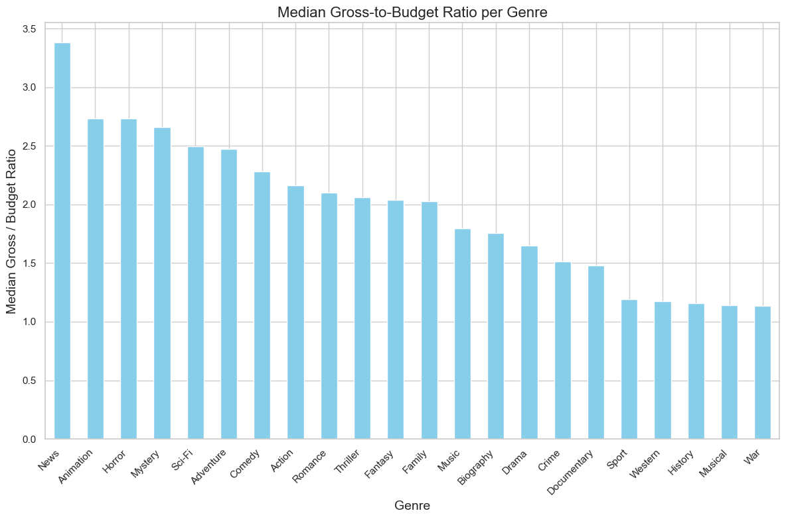
Gross/budget ratios per genre

Slide 16
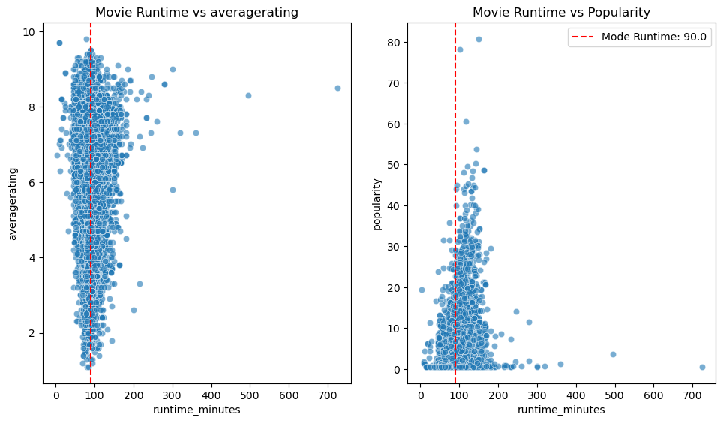
Runtime recommendations
Runtime-ratings relationship.
We recommend that production teams prioritize films with runtimes between 90-120 minutes.
Our findings revealed that this is the industry’s "sweet spot" for balancing audience engagement, critical reception, and box office performance.

Slide 17
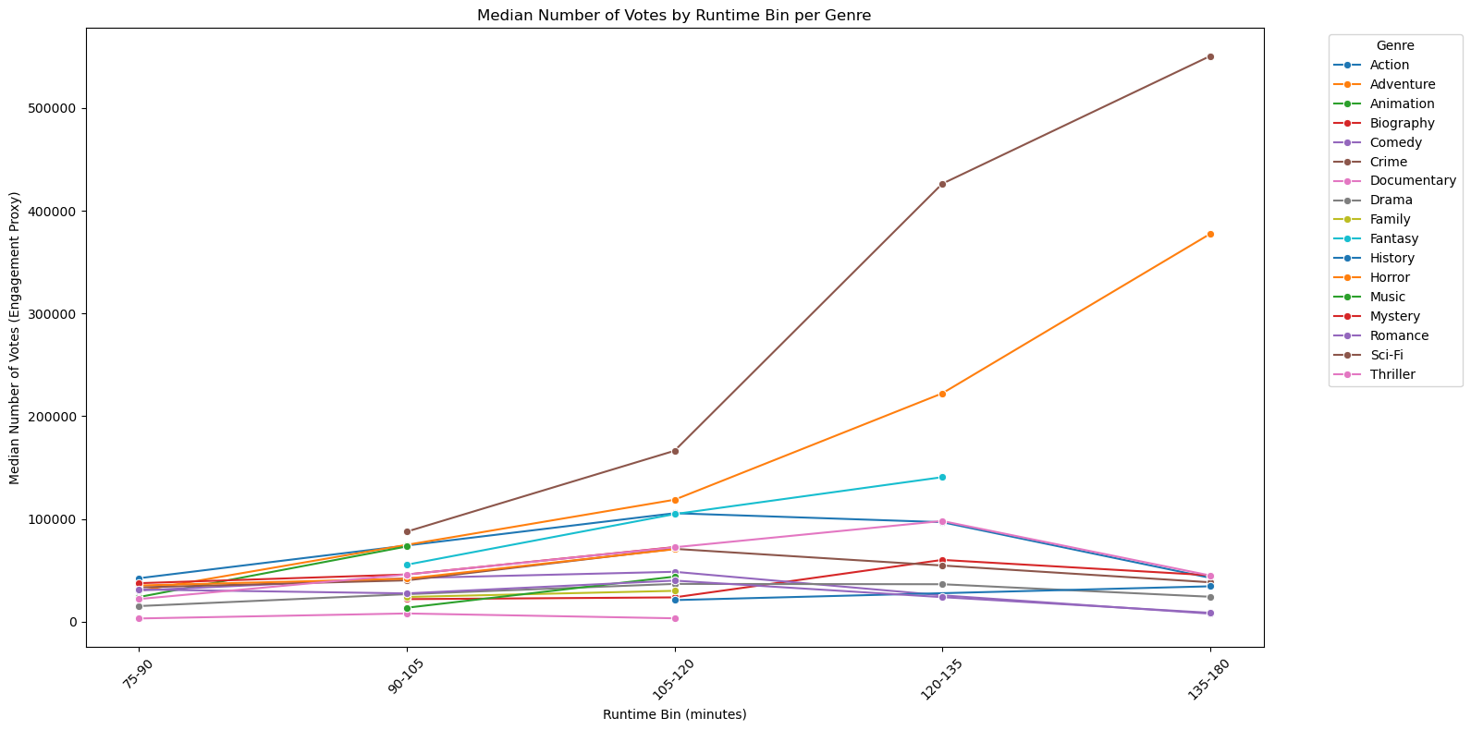
Genre-specific engagements
We Strongly recommend the use of genre-specific benchmarks when planning film length.
- We found that;
Due to fan expectations, action / Drama / Sci-Fi films can tolerate slightly longer runtimes.
Comedies, thrillers, and animation should target tighter runtimes for better audience retention.

Slide 18
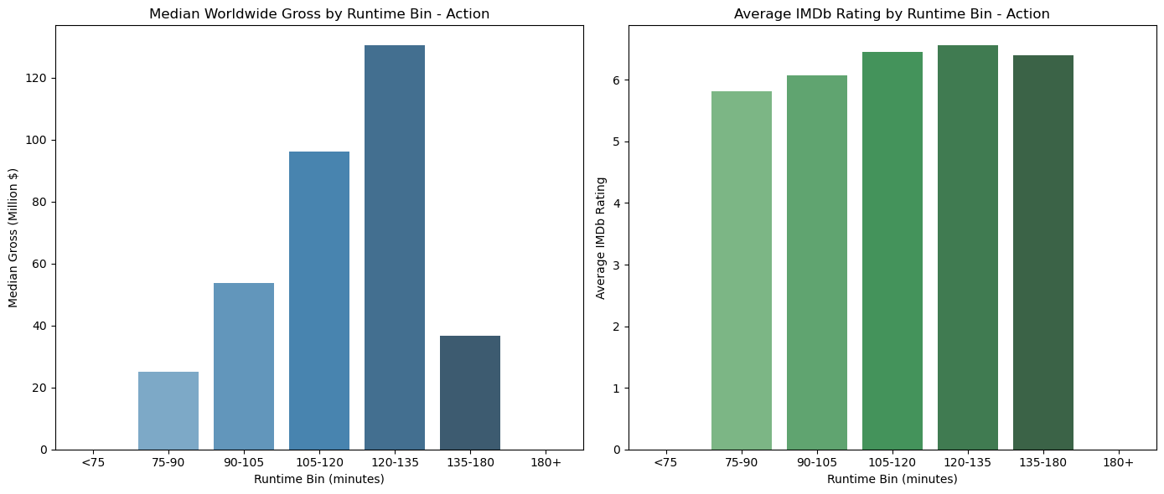
Worldwide gross by runtime and ratings
To minimize audience drop-off and maximize repeat viewing, avoid extremes (films that are too short or excessively long).

Slide 19
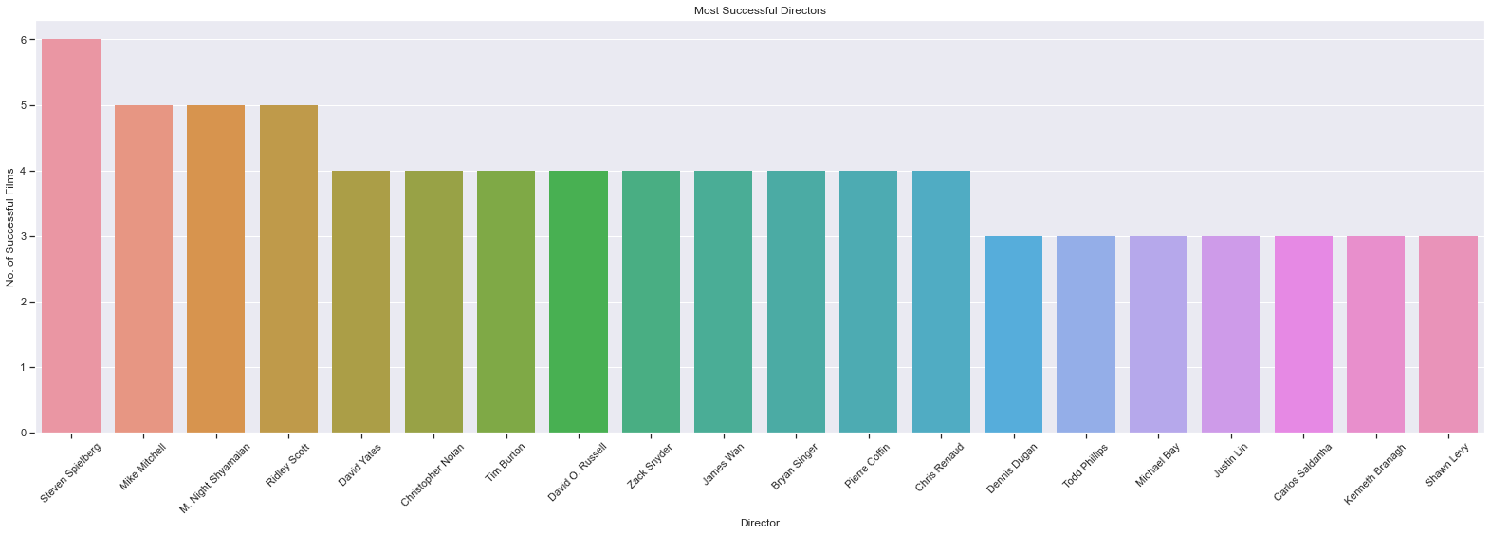
Talent recommendations
Directors.
We recommend directors such as 'Steven Spielberg', 'Mike Mitchell', 'M. Night Shyamalan', 'Ridley Scott’, and 'Tim Burton’ be a part of the company’s production team. These are some of the directors who directed several high-revenue movies.

Slide 20
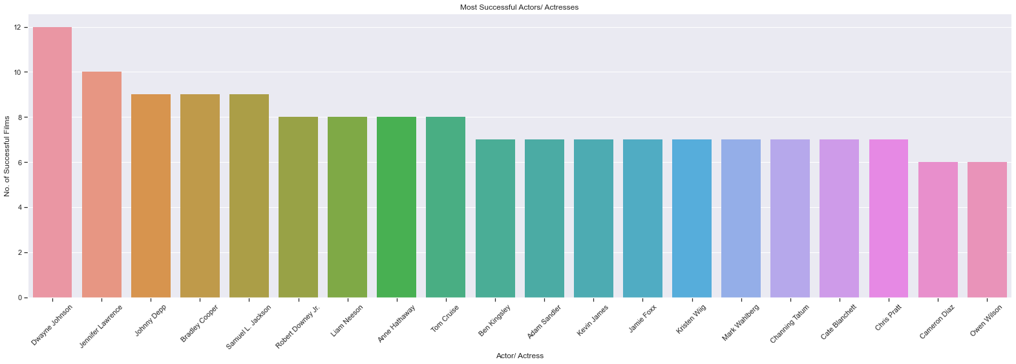
Actors
We recommend hiring and including actors like 'Dwayne Johnson', 'Jennifer Lawrence', 'Johnny Depp', 'Bradley Cooper', 'Samuel L. Jackson', 'Robert Downey Jr.', 'Liam Neeson', 'Anne Hathaway', 'Tom Cruise’, and 'Ben Kingsley’, in the studio’s contents. These are some of the actors who appeared severally in high-earning films therefore cementing our beliefs that they have influence in the film industry.

Slide 21
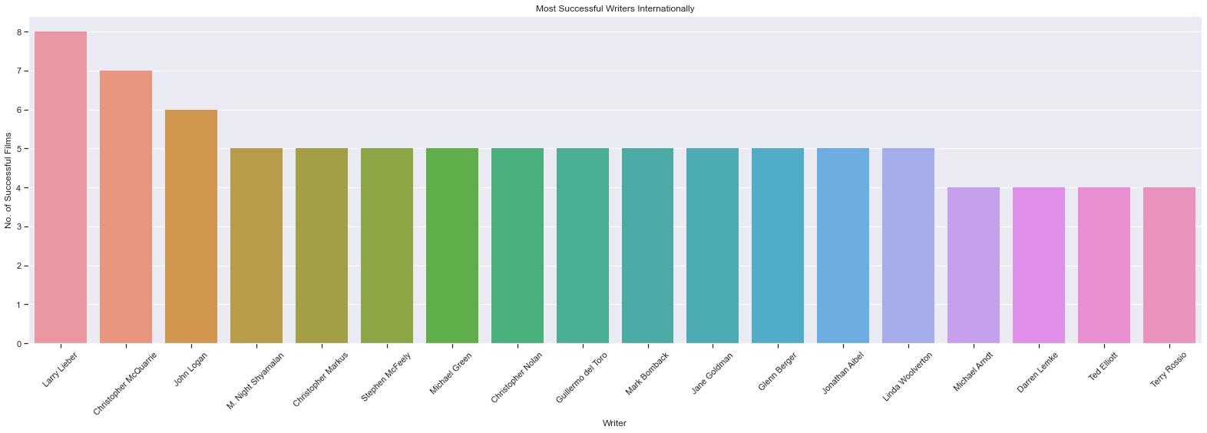
Writers
After careful considerations, the team recommends ‘'Larry Lieber', 'Christopher McQuarrie', 'John Logan', 'M. Night Shyamalan', 'Christopher Markus’, and 'Stephen McFeely’ as the company’s playwright. Our analysis identified them as some of the most brilliant writers in the film industry with several of their movies topping the revenue charts.

Slide 22
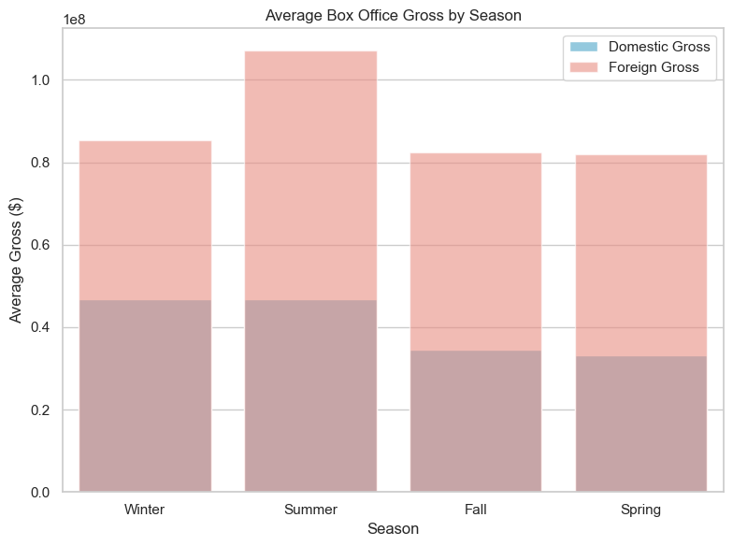
Release strategy and revenue optimization.
Best-Performing Release Seasons
We recommend scheduling blockbuster releases during Summer to capitalize on peak cinema attendance.
We also recommend you target family-friendly and fantasy titles for Winter holidays when family audiences surge.
Additionally, use Spring and Fall as tactical slots for lower-budget or niche genre films where market competition is softer.

Slide 23
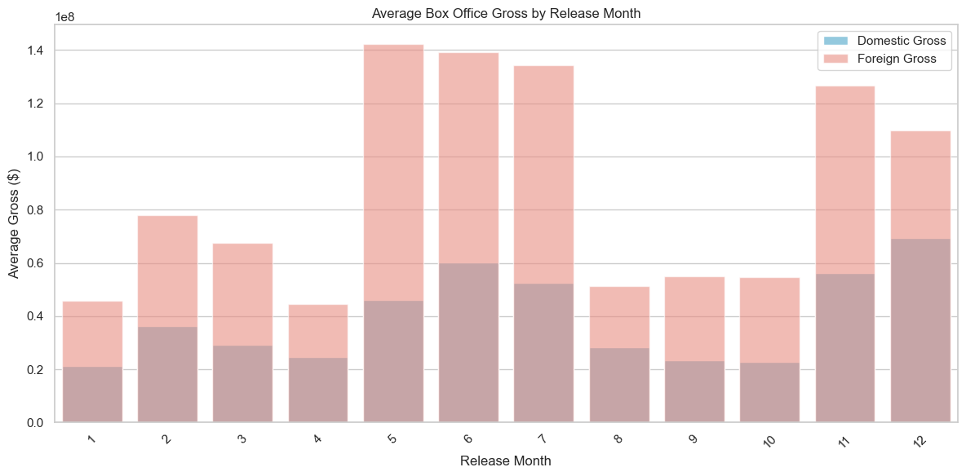
Best-performing release months.
In support of the previous recommendations, we add that the months of May, June, July, November and December are the best months to release the films.

Slide 24
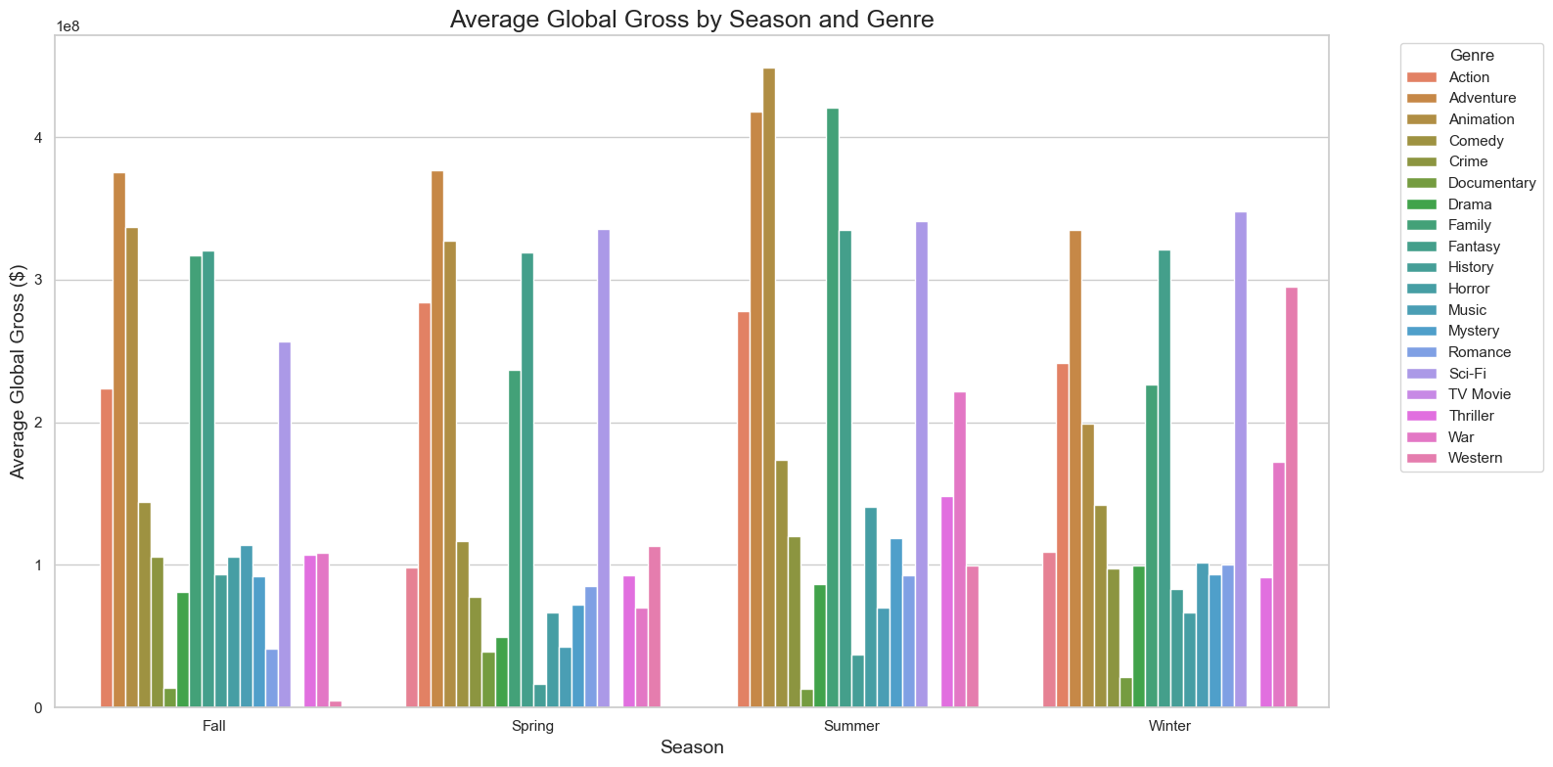
Lastly, we recommend that the company align release schedules with seasonal genre strengths;
Action/Adventure/Sci-Fi → Summer
Family/Fantasy → Winter Holidays.
Horror → October.
Drama/Romance → Fall
Plan season-specific marketing campaigns that play into seasonal moods and events (e.g. holiday-themed promotions, summer blockbuster hype).

Slide 25
Summary.
In launching the new studio, we recommend a balanced approach:
Target optimal runtimes per genre.
Build teams with high-ROI actors, directors, and writers.
Focus on profitable genres while balancing with big-brand opportunities.
Diversify the portfolio to manage risk and drive consistent revenue.
Think globally - position films for international success.

Slide 26
Next steps.
Set specific objectives - Translate the recommendations to concrete goals.
Resource allocation - Estimate costs for development, production, marketing and distribution.
Project selection - Choose which concepts to pursue.
Workflow and timeline planning - Break projects into phases with deliverables.
Risk assessment & contingency planning - Identify risks and prepare backup plans.
Marketing and distribution planning - Define release strategies, target markets and campaign timelines and promotional partnerships.
Monitoring and KPIs - Decide how success will be tracked and set up dashboards or regular reporting routines.
26

Slide 27

Q & A

Slide 28






Thank you
Wamuyu Gitonga
Team Lead
Vanessa Sandra
Natalie Wanjiku
Lilian Wangui
Feel free to email us at any of the email addresses below;
wamuyugitonga@gmail.com
veesandra30@gmail.com
samiellesimple@gmail.com
lilianwangui266@gmail.com
leemwa244@gmail.com
jnnjogu6@gmail.com
Leejay Mwakereti
John Njogu

